Slide 1
UNIT -4
PRODUCT & PRICING

Slide 2
PRODUCT
MEANING
It is an object or system made available for consumer use
It is anything that can be offered to a market to satisfy the desire or need of a customer.
A service is also regarded to as a type of product

Slide 3
Definition
A product can be a service or an item.
It can be physical or in virtual or cyber form.
Every product is made at a cost and each is sold at a price.
The price that can be charged depends on the market, the quality, the marketing and the segment that is targeted.

Slide 4
Each product has a useful life after which it needs replacement, and a life cycle after which it has to be re- invented.
In FMCG parlance, a brand can be revamped, re-launched or extended to make it more relevant to the segment and times, often keeping the product almost the same.

Slide 5
New Product Development
1. Generation of New Product Ideas
2. Screening of Ideas
3. Product Concept Development
4. Commercial Feasibility
5. Product Development
6. Test Marketing
7. Commercialisation

Slide 6
1. Generation of New Product Ideas:
Ideas may come from internal sources like company’s own Research and Development (R&D) department, managers, sales-force personnel etc.; or from external sources like, customers, dealers, competitors, consultants, scientists etc.
At this stage, the intention of management is to generate more and more new and better product ideas; so that the most practical and profitable ideas may be screened subsequently.

Slide 7
2. Screening of Ideas:
This means a close and detailed examination of ideas,
-to determine which of the ideas have potential and are capable of making significant contribution to marketing objectives.
-Unique designs that lower costs or give performance advantages are also considered

Slide 8
3. Product Concept Development
Those product ideas which clear the screening stage must be developed into a product concept – identifying physical features, benefits, price etc. of the product.
At this stage product idea is transformed into a product concept i.e. a product which target market will accept

Slide 9
4. Commercial Feasibility
At this stage, the purpose is to determine whether the proposed product idea is commercially feasible(capable to be carried out), in terms of demand potential and the costs of production and marketing.
Management must also ensure that product concept is compatible with the resources of the organization technological, human and financial

Slide 10
5. Product Development
Product development encompasses the technical activities of engineering and design.
At this stage, the engineering department converts the product concept into a concert form of product in view of the required size, shape, design, weight, colour etc. of the product concept.

Slide 11
A model or prototype of the product is manufactured on a limited scale.
Decisions are also made with regard to packaging, brand name, label etc. of the product.

Slide 12
6. Test Marketing
A sample of the product is tested in a well-chosen and authentic sales environment; to find out consumers’ reaction.
In view of consumers’ reactions, the product may be improved further

Slide 13
7. Commercialisation
Steps are taken to launch a full-fledged programme for the production, promotion and marketing of the product.
It is the stage where the new product is born; and it enters it life cycle process.

Slide 14
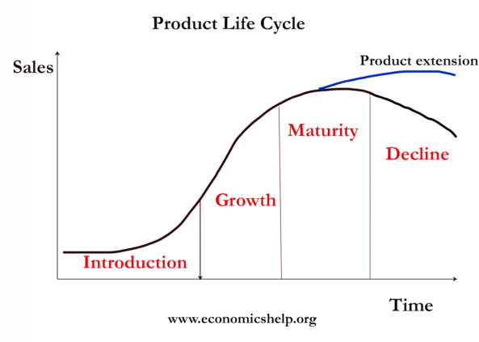
Product life cycle:

Slide 15
1.Introduction
In this stage, the product is being released into the market.
When a new product is released, it is often a high-stakes time in the product's life cycle - although it does not necessarily make or break the product's eventual success.

Slide 16
Costs are generally very high and there is typically little competition.
The principle goals of the introduction stage are to build demand for the product and get it into the hands of consumers, hoping to later cash in on its growing popularity.

Slide 17
2.Growth
Here, consumers are already taking to the product and increasingly buying it.
The product concept is proven and is becoming more popular - and sales are increasing

Slide 18
If competition for the product is especially high, the company may still heavily invest in advertising and promotion of the product to beat out competitors.
As a result of the product growing, the market itself tends to expand. The product in the growth stage is typically tweaked to improve functions and features.

Slide 19
3.Maturity
At this point, sales can even start to drop
Pricing at this stage can tend to get competitive, signaling margin shrinking as prices begin falling due to the weight of outside pressures like competition or lower demand

Slide 20
companies will often develop new or altered products to reach different market segments
it is typically in the maturity stage of a product that less successful competitors are pushed out of competition
The maturity stage may last a long time or a short time depending on the product

Slide 21
4.Decline
product sales drop significantly and consumer behavior changes as there is less demand for the product.
The company's product loses more and more market share, and competition tends to cause sales to deteriorate
Eventually, the product will be retired out of the market unless it is able to redesign itself to remain relevant or in-demand.

Slide 22
For example, products like typewriters, telegrams and muskets are deep in their decline stages (and in fact are almost or completely retired from the market)

